Slide 1
Shift Team Six
Cody Ezell (Team Lead)
Steven Davis
Corey Welborn
Matthew Crocker
Zachary Light

Slide 2

Quik-Ventory

Slide 3
What is Quik-Ventory?
Quik-Ventory is an applications that helps the user keep track of inventory using either a barcode scanner or manual input.
Can be used both in business settings – to keeping track of stock – or individual use – tracking personal belongings for insurance purposes.

Slide 4
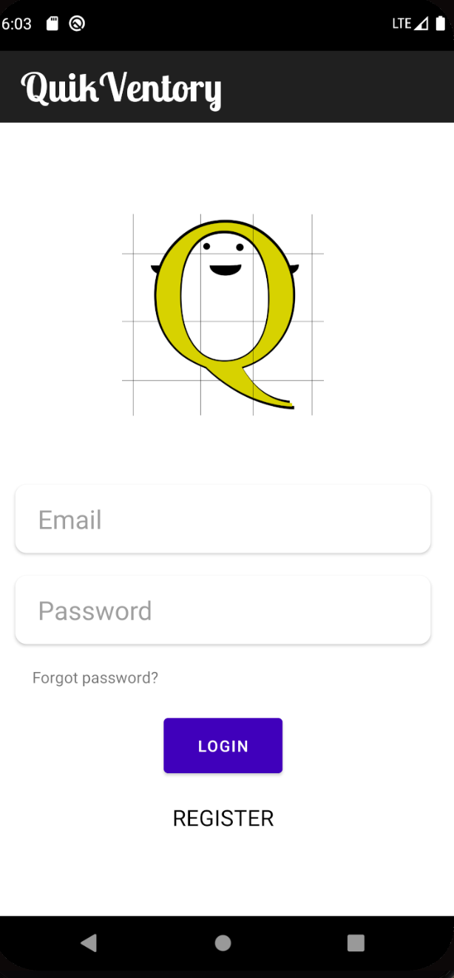
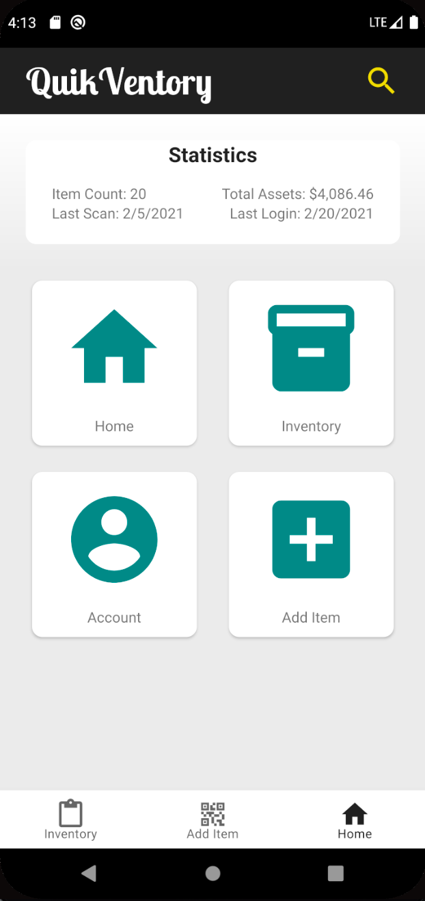
High level requirements
User shall be able to Register, Login, and Logout.
User shall be able to Scan a Barcode and Store the Item in Database.
User shall be able to Add, Edit, Delete, or Create Items Manually.
User shall be able to View, Sort, and Search Items.
User shall be able to Reset Password if Forgotten.

Slide 5
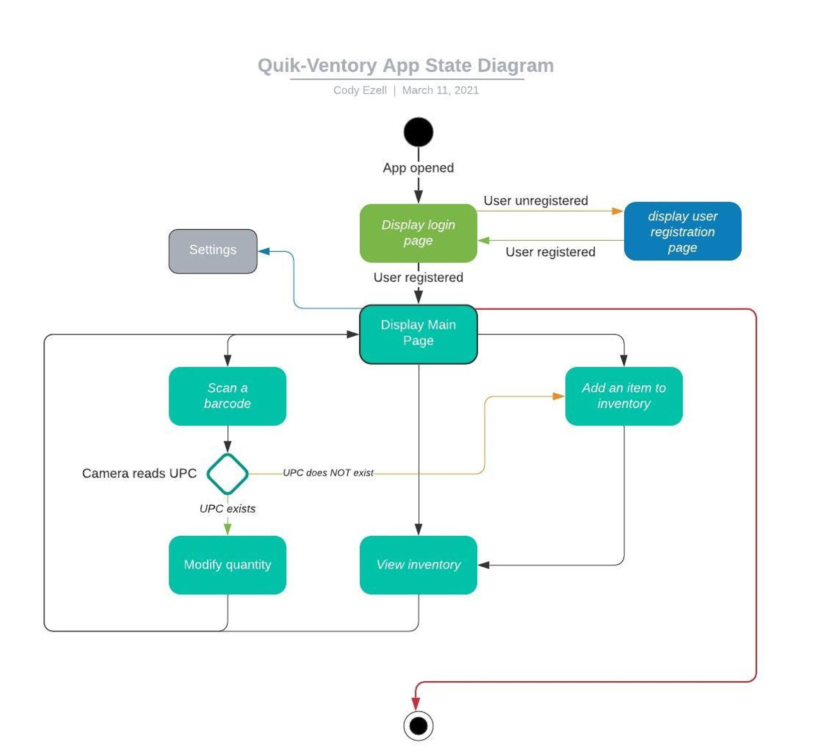
State Diagram

Slide 6
Test plan
Make simple calls to test database connectivity.
Tested Database
Created multiple user accounts.
Sign in and out of each.
Created a few unique test items under at least two accounts to test separation of databases
View the database for each account to be sure they are separate.
Adjust each category for any one item. Only change 1 category at a time.
Do this for a few items in each database
Check for changes
Adjust multiple categories at a time for several items in each database. Check for changes
Adjust all categories at once for several items in each database. Check for changes
Deleted an Item in each database. Check the databases to be sure the items are gone on app.
Device Compatibility
Tested the app on an android device
Tested inventory buttons and logout functions
Tested scanner
Scan multiple new items

Slide 7
Incomplete Segments (Stubs)
Search Button
Exists but not coded. Should populate a list of items according to the search criteria. Searches based on item names.
Login Fragment - Register Option
Never implemented. Ran out of time.
Would links to a new fragment to allow a user to input email, username, and password. Sends data to database using a stored procedure that verifies originality of account.
Login Fragment - Forgot Password
Never implemented. Ran out of time
User would input email and the database would send a link to the email to change password. Would link to the register fragment and essentially re-register the user using a different stored procedure
Item Details
Fragment created but not linked to app nor coded to interact with database. Also missing a 'Delete' button.
Should load after clicking on item in inventory or scanning an existing item and populate with the current data of the item. User should be able to update select details of an item or delete the item
New Item
Fragment created but not linked to app nor coded to interact with database.
After a barcode is scanned, item id and user id should be sent to new item fragment. There a user can fill in other item details and add to database.

Slide 8

QUESTIONS?

